Slide 1
Date – Title and name of the speaker

Slide 3
Subtitle
Text in First Level has no arrow
Text in second level has an arrow
Text in third level has an arrow
Text in fourth level has an arrow

Slide 4
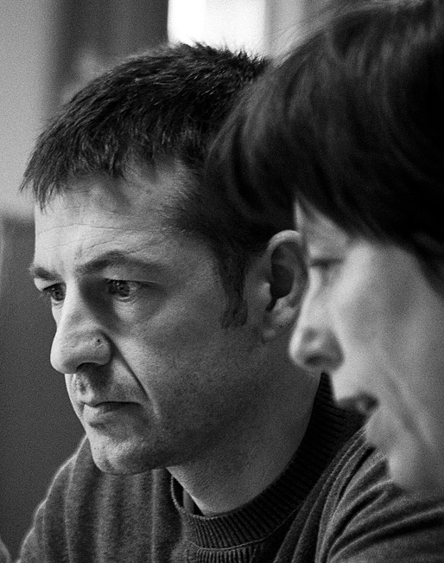
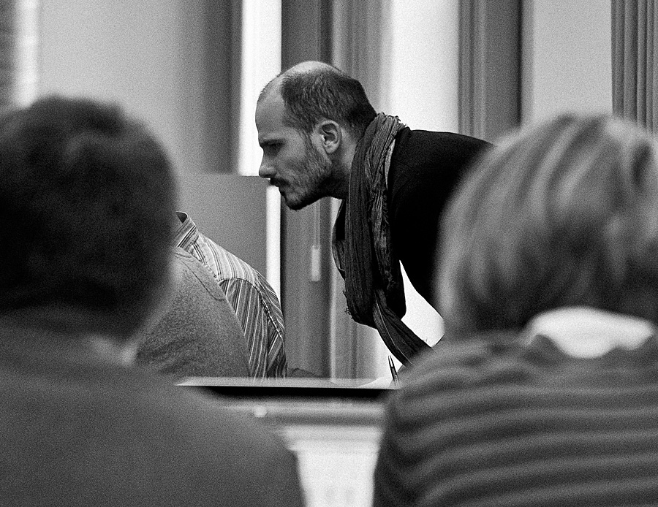
Level 1 Unt ad tem zzriliquam eumsan henisi blamet ulputpatummy nostis dolorti ncipit wis nulluptatie tisi. Tissendrem iuscil ut nibh euipisl utpat.
Onse tat nit inim at nibh euipit ipsustrud dolore ex exero et lut eugait nulla conse modolut wis nibh exercipit illuptat illutatin henit ad magniatummy nos ent aut pratem qui tat niamconsenit num ipsum autpati onsendit irilit luptat dolorem iusciduipit etuer si blamcon sendre tem quipsum quat la conum

Slide 5
Graphs
Level 1 Unt ad tem zzriliquam eumsan henisi blamet ulput patummy nostis dolorti eumsan.
Notes:
You can save this graph as a template on your PC:
The Pie Chart can be saved as a template on your PC
Double click the graph -> click on “Save As Template” (top left of the screen) -> e.g. ”AMS Pie Chart”
If you want to re-use the chart:
Create a new Pie Chart -> Click on “Change Chart Type” -> Click on Templates (Top left) and Choose “AMS Pie Chart”
The chart will be updated to the new colors.

Slide 6
OPENING MINDS TO IMPACT THE WORLD

